Slide 1
Allocation Model for two sided Market

Slide 2
Background
Optimization model for the scoring algorithm for a global information services company based on the ratings.
Research Question to be Answered
How client's job requests are allocated to vendors dynamically given the parameters quality, cost, responsiveness and turnaround time?

Slide 3
Assumptions
Forced Ranking method is used for job allocation - Top 4 Vendors.
When 4 vendors are not available the jobs are allocated to the available vendors.
Vendors read from the input file are checked-in and ready for job allocation.
When the maximum score is less than 85 the model waits for 20 minutes for the input to be read

Slide 4
Approach
Linear programming for the optimization model
Unique score creation ( Vendor score * job * job_priority _score) for maximizing the allocation
Jobs are prioritized based on the in time : First in First out approach
Different scenarios created to stress test the model

Slide 5
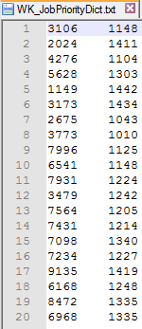

Data set
The model needs two inputs files
Jobs and arrival time
Scores for individual vendors, vendor id.

Slide 6
Data Mining and Analysis Methodology
Linear programming model to get the scoring algorithm. Initially we formed a basic static linear programming model using Gurobi optimizer and extend this model for dynamic data.
In the model we are maximizing quality, turnaround and responsiveness and minimizing the cost by allocating the jobs to vendors.
For ‘m’ jobs and ‘n’ vendors, we have ‘m*n’ decision variables which consists of binary values. These values indicate whether job has been allocated to a particular vendor depending on four scoring factors (quality, turnaround, responsiveness and cost).

Slide 7
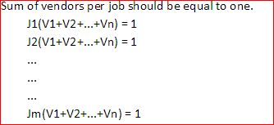
Constraints
Vendors can have multiple jobs but one job can have only one vendor
Allocation constraints were implemented based on forced ranking scenarios

Slide 8
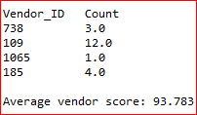
Scenario 1
Number of Vendors: 6
Number of Jobs: 20
Allocation by the model

Slide 9

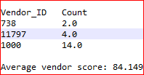
Scenario 2
Number of Vendors: 3
Number of Jobs: 20
Allocation by the model

Slide 10

Scenario 3
Number of Vendors: 1
Number of Jobs: 20
Allocation by the model

Slide 11
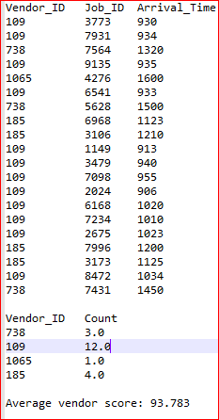
Scenario 4
Exponential Job Distribution
Number of Vendors: 6
Number of Jobs: 20
9AM to 10AM: 8 jobs
10AM to 11AM: 4 jobs
11AM and beyond: 8 jobs

Slide 12
Thank You

